Slide 1


SocialBuzz
Most Popular Contents

Slide 2


Today's agenda
Project recap
Problem
The Analytics team
Process
Insights
Summary

Slide 3

Social Buzz is a social media company that was founded in 2010. Currently, it is experiencing rapid growth and must swiftly adjust to its expanding global presence. To tackle the challenges faced by the company, Accenture has proposed a 3-month initial project, leveraging its expertise.
The project has 3 different objectives:
An audit for firm’s big data practice;
Analyzing the firm’s Initial Public Offering strategy and giving recommendations;
Data analysis to discover the top 5 most popular content categories.
Project Recap

Slide 4

Problem
500,000,000 active users per month and 100,000 posts per day make it difficult to handle the data and follow the trends.
There are various methods to react to the posts published within social media that every reaction types’ values needs to be analyzed to uncover the posts’ popularity.
The primary objective is to identify the top 5 categories that have the highest level of popularity.

Slide 5



Chief Technology Architect
Andrea Fleming
The Analytics team
Senior Principal
Marcus Rompton
Data Analyst
Mughdat Hajizada

Slide 6
Process
1
Data Understanding – choosing relevant datasets
2
Data Cleaning – removing NA values
3
Merging Datasets – combining different datasets using ID values
4
Data Analysis – preparing final dataset and discovering the most popular contents
5
Interpretation – presenting the results and showing the actual trends

Slide 7
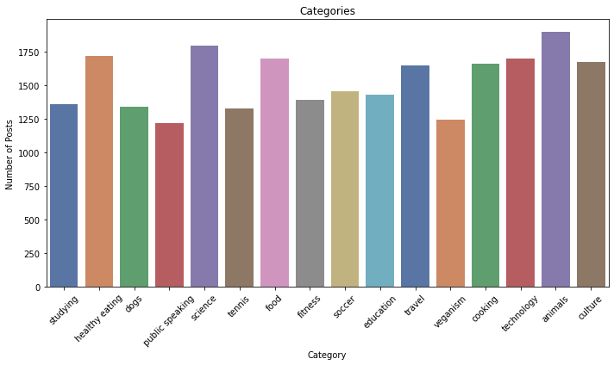

INSIGHTS
There are total of 16 different category types exist. Most common ones are animals, science, health eating and food with the number of posts equal or more than 1700.
January (781)
month with most posts

Slide 8
INSIGHTS
The most popular content is animals, while science, healthy eating, technology and food contents follows the trend, accordingly.

Slide 9
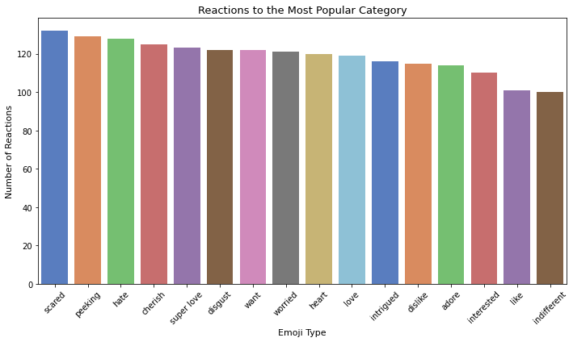
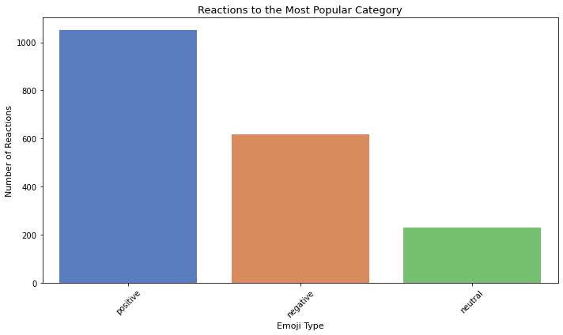
INSIGHTS
The given graphs shows the most reaction types to the most popular category – animals. Mostly positive feedback was given to this category.

Slide 10

It is evident that users are highly engaged with animal-related posts. This category gathers the most attention and generates significant interest among users. Moreover, the impressions and feedback received for animal-related posts are mostly positive, indicating a favorable sentiment towards this category.
Apart from animal-related posts, the top 5 categories that also attract user attention and engagement include healthy eating, technology, science, and food.
From the analysis, it can be observed that food related contents (healthy eating and food) and technology & science are related categories. It can show the common interests of the audience.
Summary

Slide 11
Thank you!
ANY QUESTIONS?

